Slide 1
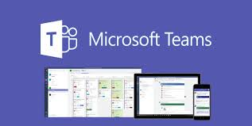
Teams Communications Walkthrough

Slide 2
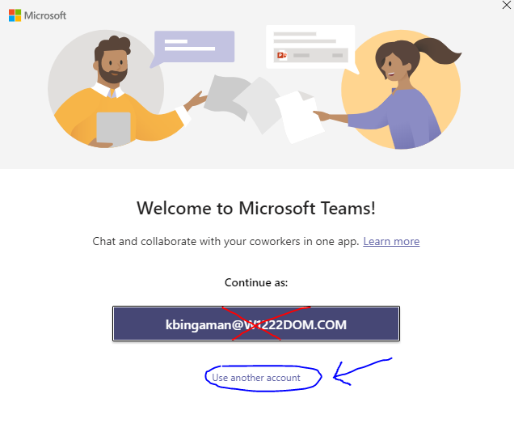
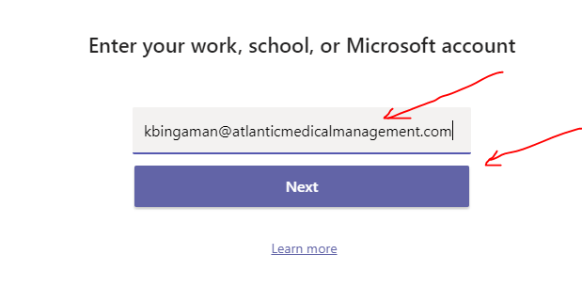
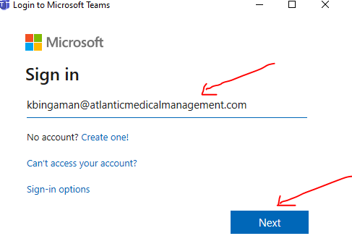
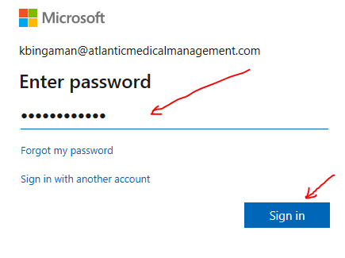
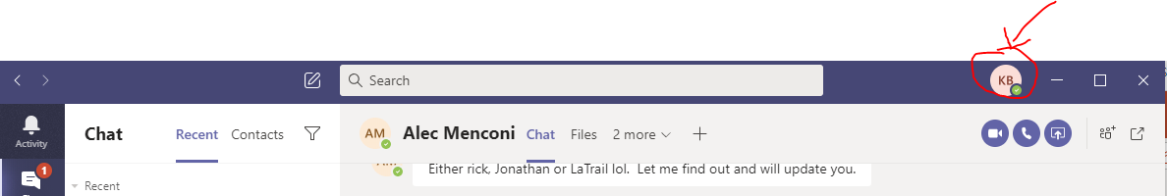
Login Process
1. open microsoft teams
Click use another account
3. Make sure email is correct, click next
2. enter your email address
Click next
3. Enter your email password, click sign in
4. You can see you are logged in via the top right corner with your initials

Slide 3

Home Interface Options
Activity – Where you can see notifications, @ mentions, call history, reactions
Chat - See all chat logs, and conversations, also able to make calls, share screen, video chat
Teams- Connect with Groups for conversations, uploading of files, and posts

Slide 4
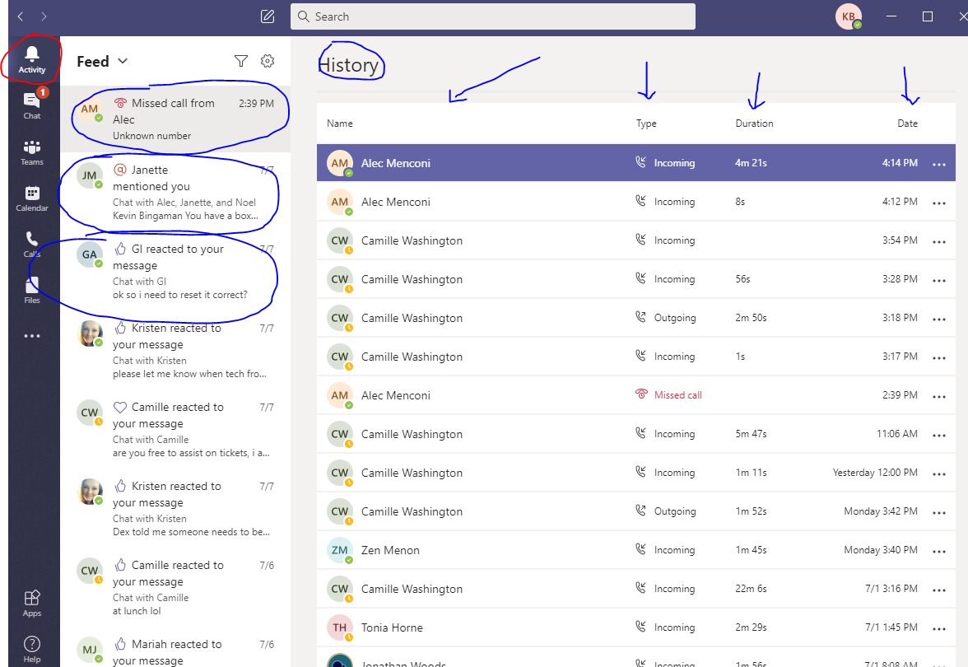
Activity Button
Reactions – Thumbs Up, hearts, etc
Mentions – uses @ symbol
e.g. @Kevin to make sure they receive extra notification
History shows all phone call logs made through Teams

Slide 5
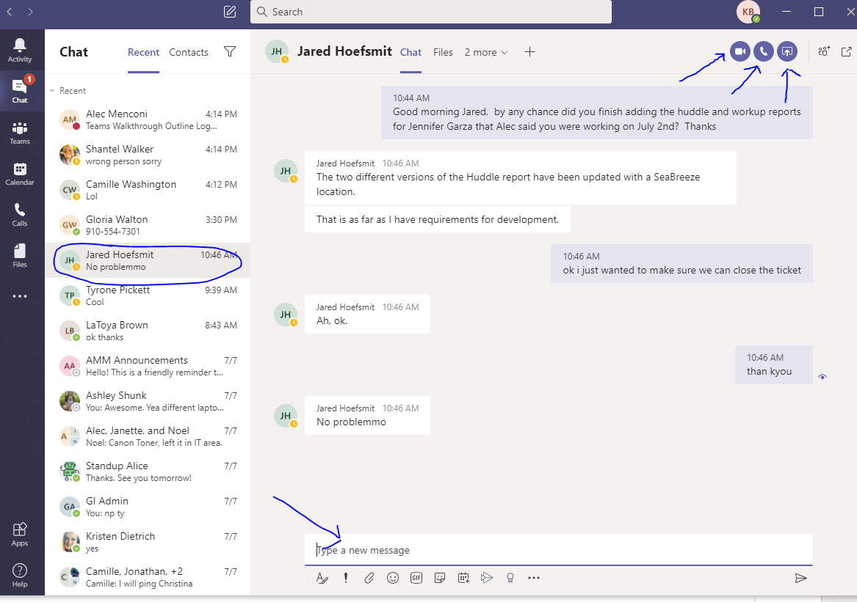


Chat Button
Start a chat by clicking on search up top and begin typing name of person you wish to chat with
Chats Organized by Most recent in the list (on left panel)
Sending message is simple using bottom message bar, and hitting enter or the > below it on right
Top Right Icons
Video Chat – through Teams
Phone – Make Call in Teams
(just like telephone)
Screen Share – can share you own screen with another for assistance

Slide 6
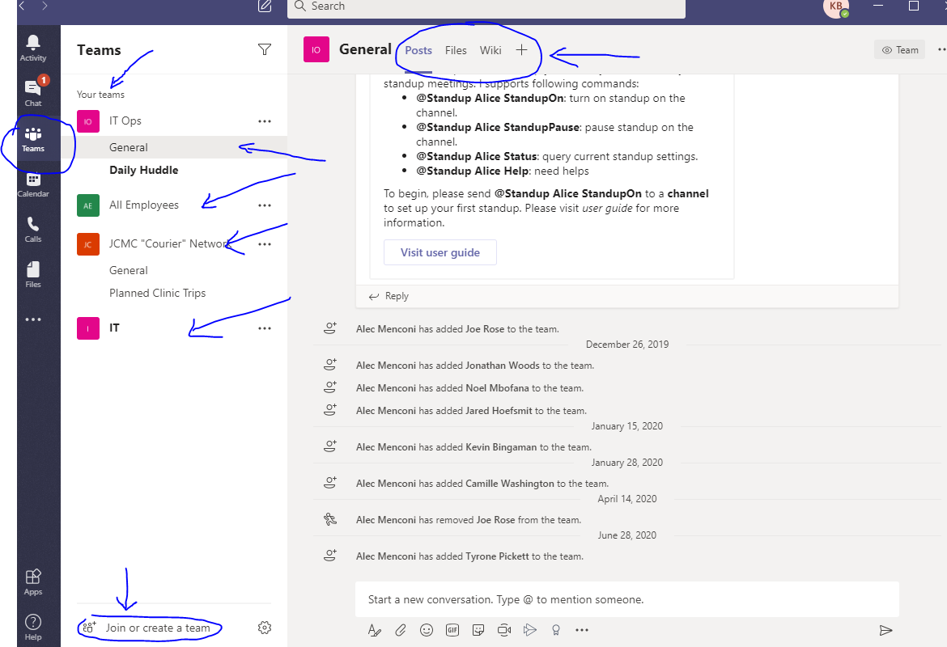
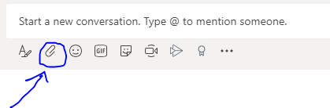
Teams Button
Create your own personalized group, or join an existing one to stay in touch with the closed set of people. This will make departmental communication easier for all in the group.
Posts – shows current log
Files – upload files for everyone to see an share
Upload by using paperclip icon

Slide 7
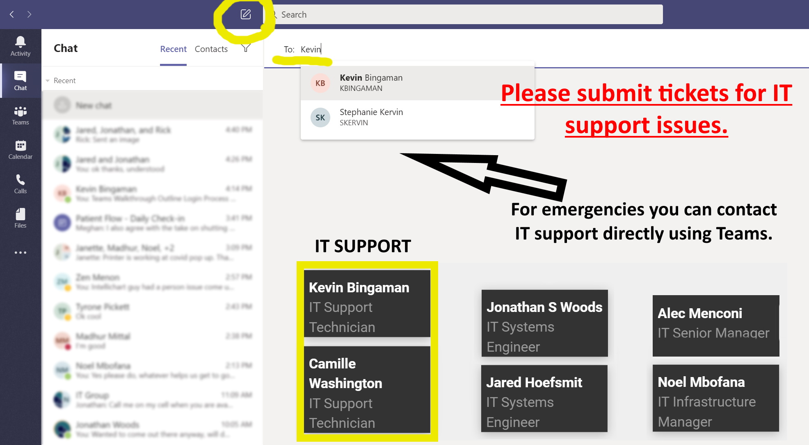
Contact Support

